Slide 1

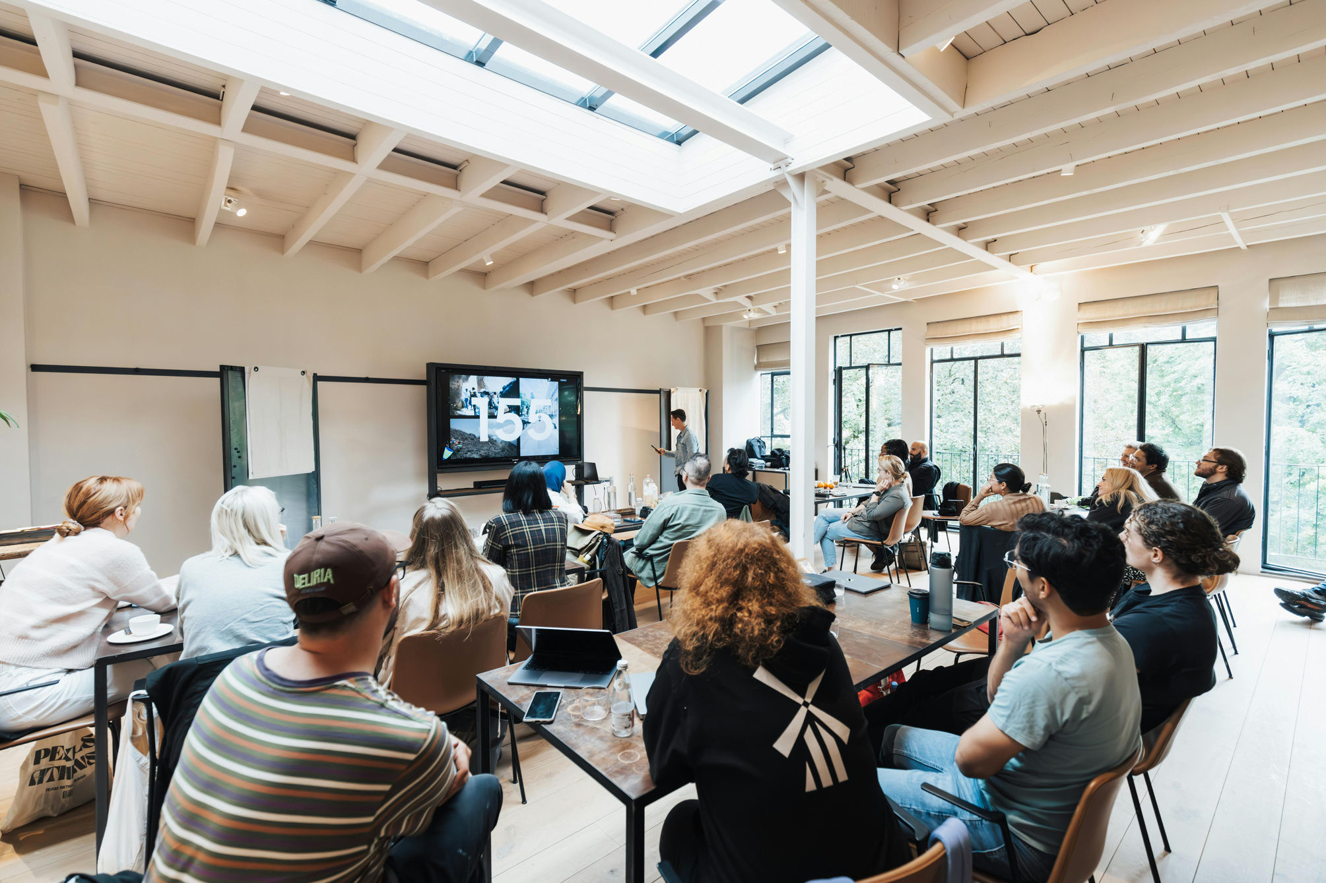



WEBXTRA TECH
Digital Skills Workshop
TRAINING & DEVELOPMENT
2025 YOUTH EMPOWERMENT
Presented for:
Dangote Group

Slide 2

Workshop Overview
This workshop is designed to equip participants with essential digital skills to excel in today’s job market.
Topics:
File Management
Online Communication
Cybersecurity best practices
On Demand Skills
Graphic Design
Video Creation
Photoshop

Slide 3


Target Audience & Benefit
1
Who should attend?
Students
Job Seekers
Professionals looking to improve digital skills
2
Benefits:
Increased Productivity
Better job prospects
Improved data security Awareness

Slide 4
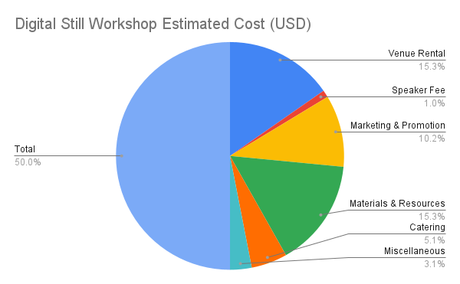

Slide 5




Contact Information
Secure your spot today!
Date: 24th June 2025
Location: No 23 Oasis Ave. Mushin
+2349032111705
info@webxtra.com.ng
Register at: https//webxtr.com.ng

Slide 6



WEBXTRA TECH
THANK YOU FOR YOUR ATTENTION
If you have any further questions or would like to connect sponsors to work together, please don't hesitate to reach out to us.
Our Office Location
Panarottis Pizza, Lekki, Lagos, Nigeria

